Slide 1
Project Two
Mounisri Muppidi
Phase2 Presentation
CIS680 2023 MSU

Slide 2
Table of Contents
My conditions
Final Result
The Secret Sauce
Proof of Correctness
Overall Experience
Brief Reflections
References

Slide 3
Conditions
I decided to complete my project in JAVASCRIPT language using REACTJS library which also includes HTML and CSS.
Then I used VISUALSTUDIO CODE to execute
I have experience with JavaScript and Visual studio from my previous phase, but less with Reactjs library.

Slide 4
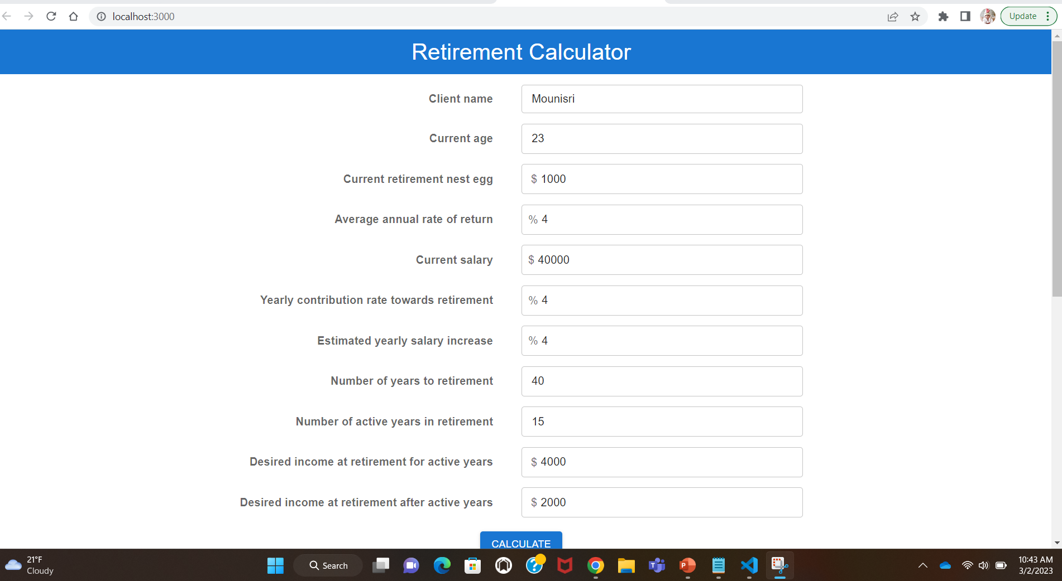
Final Result

Slide 5
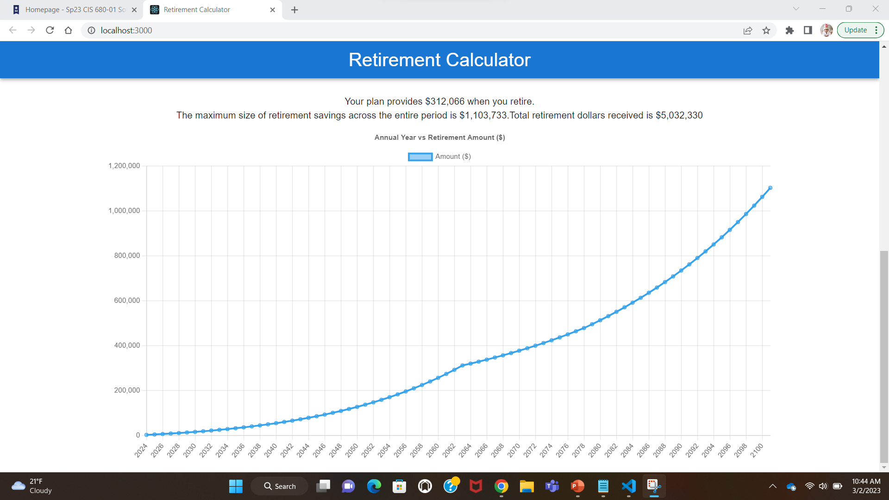
Final Result

Slide 6
Behind the scenes magic…

Slide 7
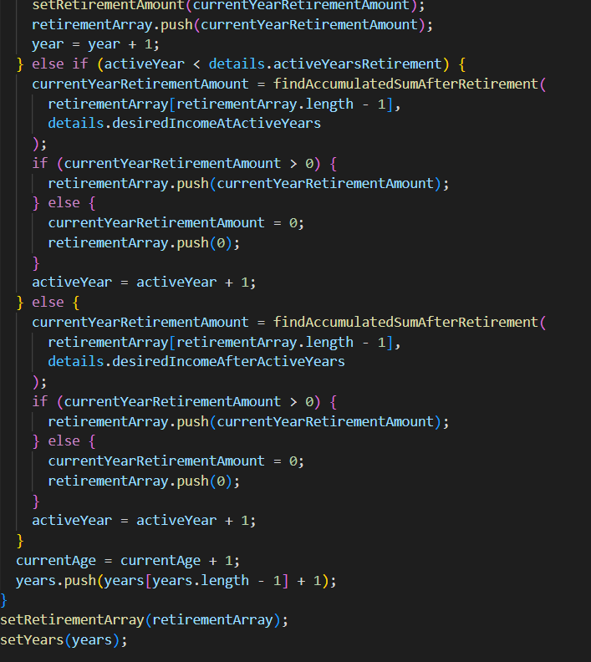
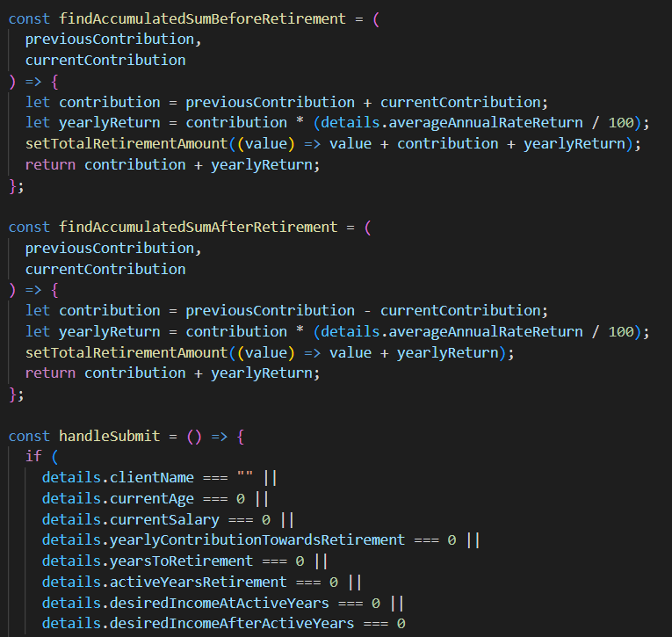
The Secret Sauce

Slide 8
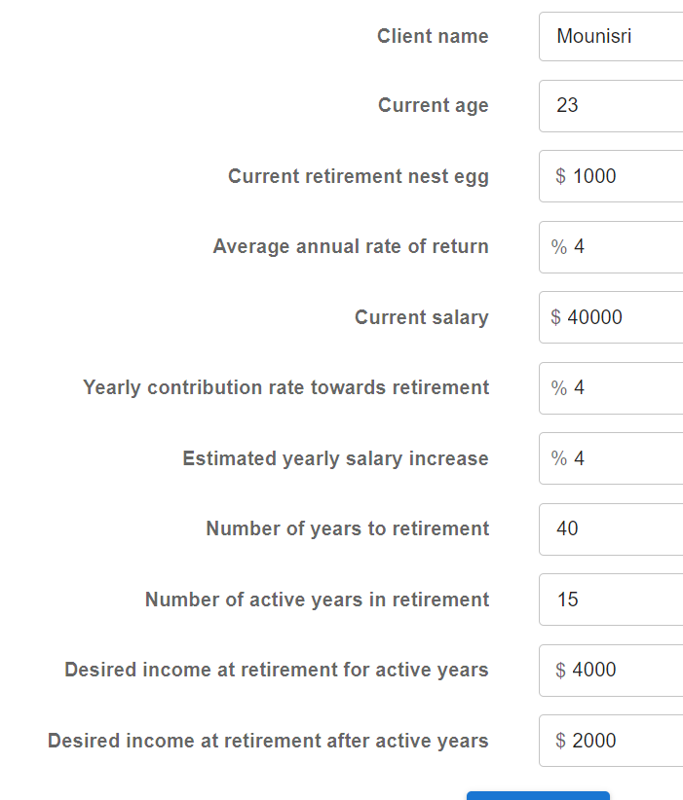
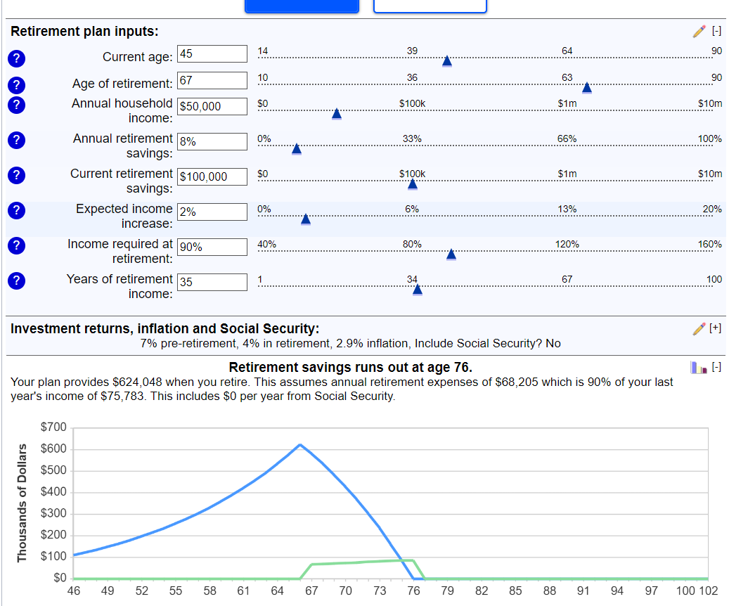
Proof of Correctness

Slide 9
Overall Experience
What went smoothly?
Same as my Phase1, JavaScript is very easy to understand and code.
Visual studio IDE is easy to edit and debug.
What was challenging?
Gathering all required formulas for retirement calculator.
Using Reactjs library is little bit hard.

Slide 10
Brief Reflections
Analysis and design
In this project, I have used while loop to traverse till age 100 or until the retirement savings amount gets to 0 and used array to store retirement amount data.
Solution options
Used agile framework, and first started to understand the required formulas for the calculator
Then started to build a sample program, and in that process, I have used several references to solve my issues.

Slide 11
Brief Reflections
Decisions and Troubles
Decided to use different libraries for this project
And as working with reactjs is new, I could not figure out some errors. Then I watched several videos and took stack overflow as my reference.
Could not understand the required formulas for the output
And had many troubles while executing the code.

Slide 12
References
https://www.bankrate.com/retirement/retirement-plan-calculator/
https://www.bankrate.com/retirement/calculators/
https://www.nerdwallet.com/investing/retirement-calculator

